Slide 1
FreeBSD Mail Server

Slide 2
Agenda
Why do this in today’s day and age?
Dangers and risks
Basics about running an email server
Setting things up together
Good practices for a mail server
Where to afterwards?

Slide 3
Meanwhile
Clone repository
Download FreeBSD ISO, base.txz, kernel.txz
Download Nextcloud ZIP
Check out the website

Slide 4
Why run your own?
Why not, if you can do it?
Privacy
Setting things up to your liking
Integration
Backup and disaster recovery
Name your own...

Slide 5
Dangers and risks
Mail not getting delivered (either direction)
Mail ending up in spam folders
The map is not the territory
Unknown exploits, 0-days, …
Data loss

Slide 6
Basics about email
SMTP
IMAP/POP
TLS/SSL, STARTTLS
Certificates
Relaying & Authentication
DNS – MX, SPF, DKIM, DMARC
Filtering for Viruses & Malware
Tarpitting
Blacklists

Slide 7
SMTP Protocol
S: 220 smtp.example.com ESMTP Postfix
C: HELO relay.example.org
S: 250 Hello relay.example.org
C: MAIL FROM:<bob@example.org>
S: 250 Ok
C: RCPT TO:<alice@example.com>
S: 250 Ok
C: RCPT TO:<theboss@example.com>
S: 250 Ok
C: DATA
S: 354 End data with <CR><LF>.<CR><LF>
C: From: "Bob Example" <bob@example.org>
C: To: "Alice Example" <alice@example.com>
C: Cc: theboss@example.com
C: Date: Tue, 15 Jan 2008 16:02:43 -0500
C: Subject: Test message
C:
C: Hello Alice. This is a test message
C: Bob
C: .
S: 250 Ok: queued as 12345
C: QUIT
S: 221 Bye

Slide 8
SMTP & IMAP/POP
SMTP 25, POP 110, IMAP 143
POP vs IMAP: Use IMAP for remote access
Plain Text-based
Inherently insecure
Security through wrapping in TLS
  STARTTLS – any port – starts with plaintext
  TLS/SSL – 465/587 and 993 – wraps from the start

Slide 9

SMTP (in)security

Slide 10
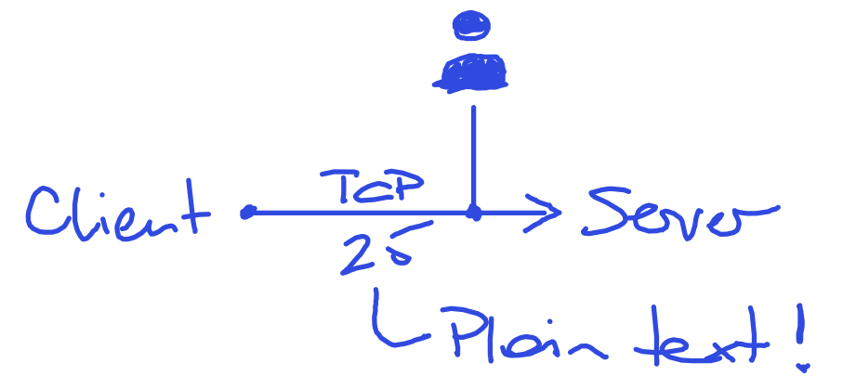
SMTP (in)security

Slide 11
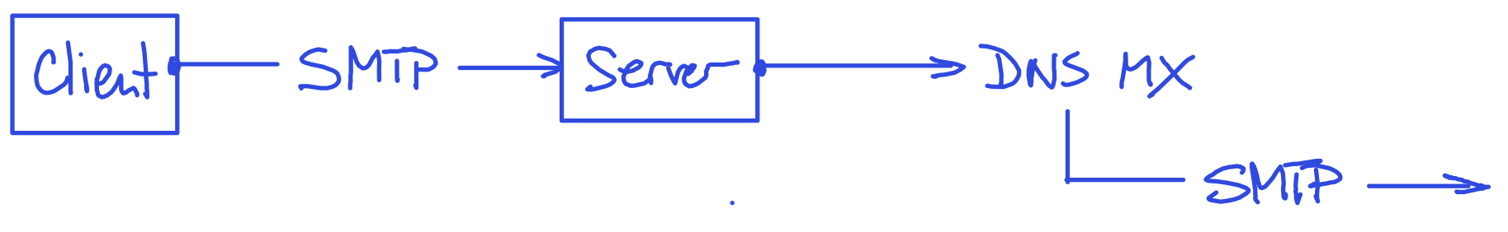
SMTP (in)security

Slide 12

SMTP (in)security

Slide 13
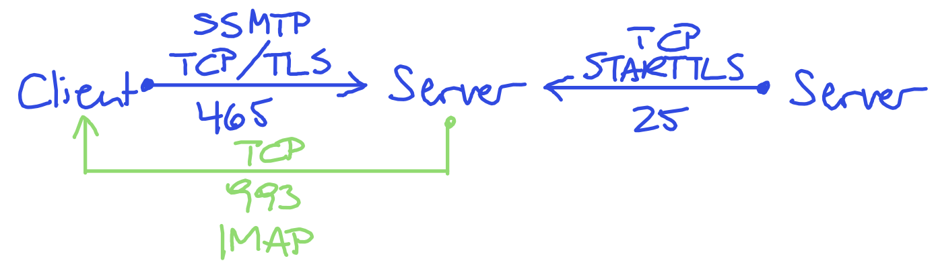
SMTP (in)security

Slide 14
Certificates
Private Key – keep secret, protect!
Public Key
Tooling
  Easy RSA – X.509, self signed CA
  Certbot & Let’s encrypt!
Issued to a specified domain/hostname

Slide 15
Core Requirements
FreeBSD 14.0 or higher
Static IP Address
Access to DNS management
Remote access via SSH or other secure means
Internet access, incl. ports 25, 80, 143, 443, 465, 993, etc.

Slide 16
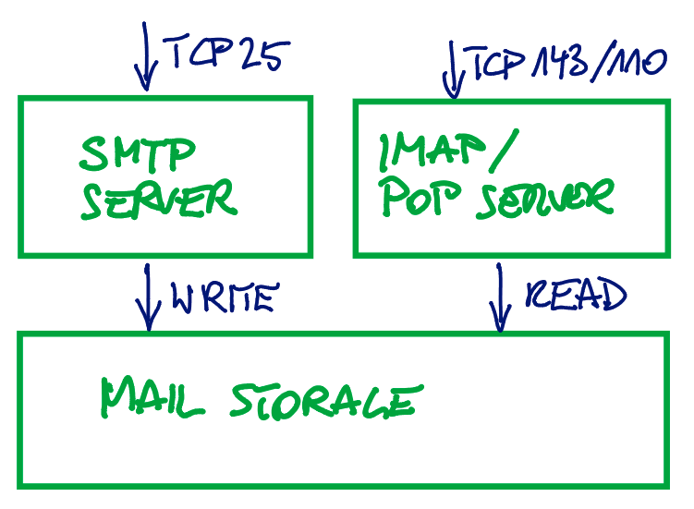
Elements of a Mail Server

Slide 17
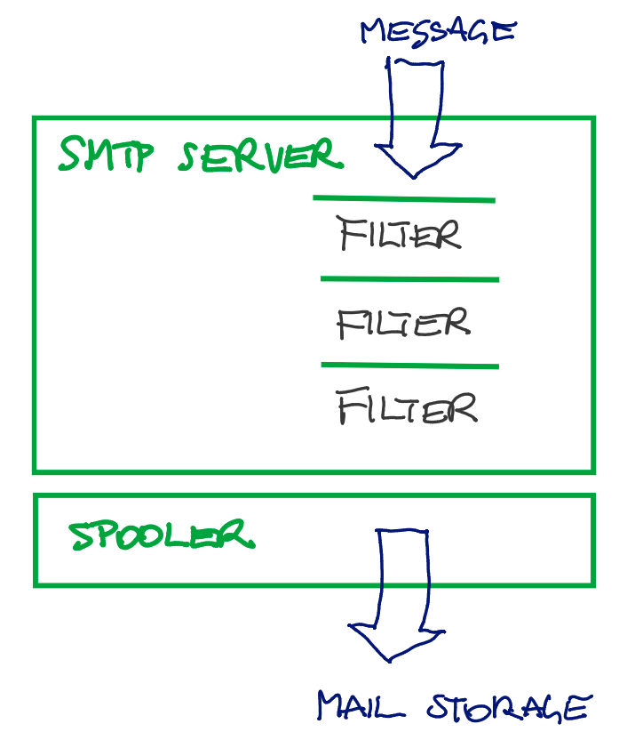

Slide 18
Relaying
Domain example.com
Hostname mail.example.com
Receiving for example.com
Sending for example.com
Open Relay: send for any other domain

Slide 19
Good Practice 1
To prevent operating as open relay, have mandatory authentication enabled
For sending to (SMTP, except for final delivery)
For receiving from (IMAP)

Slide 20
DNS - MX
The address book of the internet
MX record sets which mail server receives mail for which domain
Multiple mail servers may be specified, they are ordered by a given priority number

Slide 21
DNS - MX
The address book of the internet
MX record sets which mail server receives mail for which domain
Multiple mail server may be specified, they are ordered by a given priority number

Slide 22
DNS
Reverse DNS of our mail server should point to the same hostname as forward DNS

Slide 23
DNS - SPF
Sender Policy Framework
Defines which servers, IPs may send email
Only one SPF record per domain allowed!
Simple TXT record

Slide 24
DNS - DKIM
Public key stored in DNS
Private key remains on server and is used to sign outgoing messages
Receiving end verifies signature of message to assess authenticity of the sender
Additional indicator for spam

Slide 25
DNS - DMARC
Domain based Message Authentication, Reporting and Conformance
Verification via SPF and DKIM
Allows specifying a recipient to receive reports of unverified senders (IP addresses)
Policy none, quarantine/report, or reject

Slide 26
DMARC example
Ignore (none)
Quarantine (quarantine)
Reject completely (reject)
v=DMARC1; p=quarantine; rua=mailto:postmaster@example.org

Slide 27
Optional DNS
MTA-STS
  DNS Record points to policy on web server
  Policy specifies use of TLS
DANE
  DNS based authentication of named entities
  TLSA DNS record publishes protocol and certificate data

Slide 28
Good Practice 2
Have reverse DNS properly configured

Slide 29
Good Practice 3
Have SPF, DKIM and DMARC enabled

Slide 30
Additional anti-spam measures
Tarpitting
  Slows down sender
  Intentionally fails to make sender re-send later
Blacklists
  Registries of known IP addresses that send spam
  Unlisting may be requested, but may require time and proof that spamming stopped

Slide 31
Mail Filter
Spam Assassin filters against spam
  Verifies DKIM and SPF
  Checks against blacklists
  Runs statistics against known message patterns
Amavis runs virus scanner
  Clamav open source scanner

Slide 32
Good Practice 4
Keep your system and installed software up-to-date and use additional security measures (i.e. firewall, et al)

Slide 33
Good Practice 5
Don’t force TLS/SSL – there are still many mail servers that will simply fail otherwise
Use MTA-STS, DANE instead

Slide 34
Good Practice 6
Remember the time!
Use ntpd or other means to keep your time in check – particularly when running on a shared VM environment

Slide 35
More things to consider
Backing up mails
Restore mails
TOTP 2FA for SSH
Setting mailbox quotas
Collect and block misbehaving IPs in firewall
Enable audit framework

Slide 36
Look Ma, no hands!
We are going no-management, as little tools as necessary to do things.
There is tooling in development that does this!
You’ll know and understand how things work “under the hood” at the end!

Slide 37
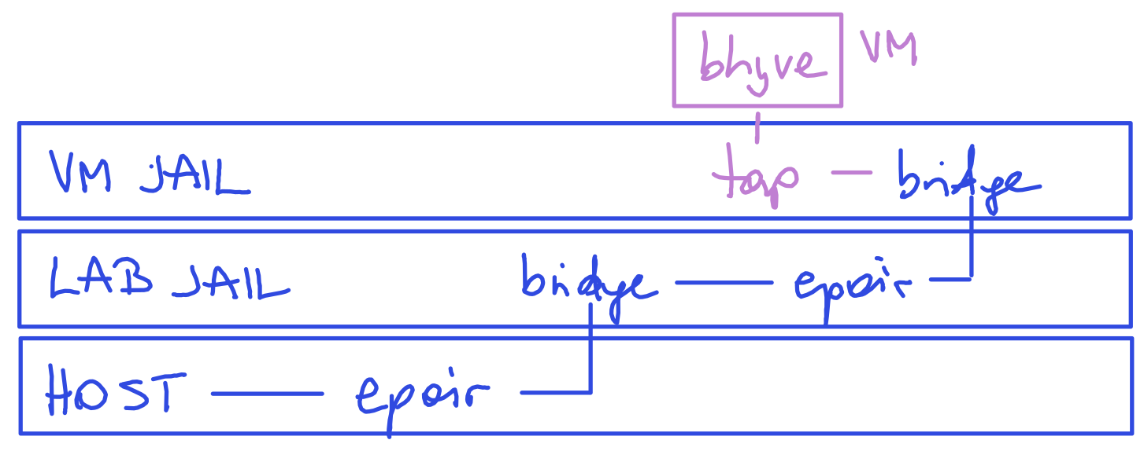
Lab Environment

Slide 38
The bhyve commands
bhyve
user space daemon
bhyveload
Load a FreeBSD kernel into a virtual machine
bhyvectl
Create and destroy a virtual machine

Slide 39
Kernel Module Loading
if ! kldstat -q -m vmm; then
if kldstat -q -n vmm; then
bail 1 "Error: VMM loaded but
not active. Is VMX disabled via
BIOS?"
fi
bail 1 "Error: VMM not loaded
(pci/ppt not active)."
fi

Slide 40

VM life cycle
bhyvectl or bhyveload – create guest
bhyve – runs guest
Downloads
bhyvectl – destroys guest
https://training.ny-central.com/bhyve101

Slide 41
Using tmux for bhyve
tmux new-session -d -s bhyve 'bhyve \
-H \
-c 2 \
-D \
-l com1,stdio \
-l bootrom,/usr/local/share/uefi-firmware/BHYVE_UEFI.fd \
-m 2G \
-s 0,hostbridge \
-s 1,ahci-cd,/lab/freebsd.iso \
-s 2,nvme,/lab/freebsd-vm/disk.img \
-s 3,lpc \
freebsd-vm'

Slide 42
Tired of typing?
bhyve supports bhyve_config files
Provide the same input as program arguments
Saves you the typing
Easy to reuse
Easy to mistype and misconfigure
Recommendation: confirm your arguments are working, then convert

Slide 43
Converting to config
bhyve <args> \
-o config.dump=1 > config
All arguments end up in config, including -o.
Remove -o config.dump=1 before using the config file! Then run:
bhyve -k config

Slide 44
Start on boot
There is no “standard” rc.script for bhyve
You can roll your own
  Use daemon to wrap around bhyve
  Define upfront: set up network before virtual machines or wrap around with cleanup?
You can use one of the existing management tools in ports
Will use our own for the lab

Slide 45
If everything else fails...
Read the manual!
man bhyve
man bhyveload
man bhyvectl
man vmm
man tmux

Slide 46
Jail Installation Methods
Use bsdinstall
Install from source
Use base.txz and kernel.txz binary packages
Use management tools (jailer et al)

Slide 47
Jail Variants
“Naked”
Thin Jail (shared root with other jails)
Full Jail

Slide 48
Watch Out!
Don’t edit your jail.conf while the jail is running!
You will have to clean up manually afterwards – particularly for network interfaces!

Slide 49
Networking
Using vnet provides separate network stack
Allows use of its own pf firewall
Requires separate IP subnet
Either routed or NAT - plan ahead to not run into IP conflicts!
vale switch or bridge (latter recommended as vale is not jails-aware)
Routed setup with vnet
Use epair to connect jail
We use IP ranges
  10.193.167.0/24
  10.191.169.0/24

Slide 50
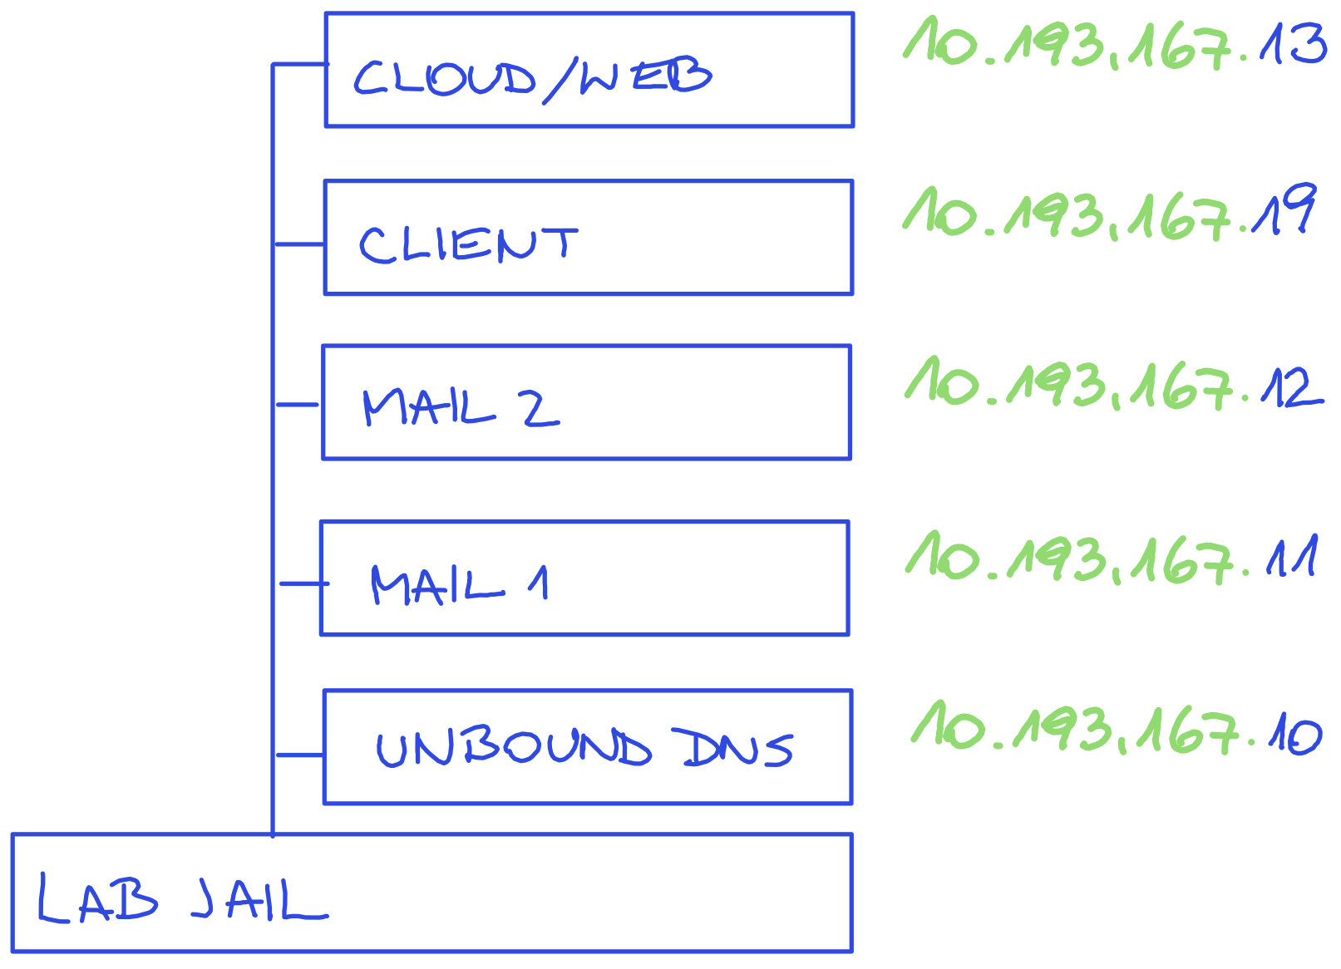
Lab Environment

Slide 51
Lab Environment
Host
epair – 10.10.10.41/30
Lab Jail
10.10.10.42/30
bridge + DHCP 10.193.167.1/24
epair
epair
epair
VM Jail 1
VM Jail 2
...

Slide 52
Lab Environment
VM Jail
epair – 10.193.167.2
bridge
epair
tapN
Sub-Sub Jail
bhyve

Slide 53
Jail Config
Using a template lab.template
Set up as /etc/jail.conf.d/lab.conf
Additional Settings to consider
sysctl security.bsd.see_jail_proc

Slide 54
Jail Config
Using a template lab.template
Set up as /etc/jail.conf.d/lab.conf
Additional Settings to consider
sysctl security.bsd.see_jail_proc

Slide 55
Jail Startup Variables
Parameter | Runs on Host | Runs in Jail
exec.prestart | ◉
exec.created | ◉
exec.start |  | ◉
exec.poststart | ◉
exec.prestop | ◉
exec.stop |  | ◉
exec.poststop | ◉
exec.release | ◉

Slide 56
Making bhyve work
Permit vmm use in jail
Set up a devfs rule to expose /dev/vmm inside jail
Add required devfs rules for tap and any other desired device nodes
Devices are masked in jail
We enable devices we need via devfs rules on host
We create a completely new rule set
We add devfs with chosen ruleset to be mounted inside jail

Slide 57
Resource Accounting
Use to limit jail and its virtual machine from hogging CPU, memory, I/O
We can set limits on the parent jail or on specific VM jails
We can kill processes that do not behave, log, or throttle (I/O)…
Does not “catch” everything (i.e. mdconfig)!

Slide 58
Caveats so far
Use bhyvectl to create a VM inside a jail
Clean up with bhyvectl after use, otherwise the VM id “drops” to the parent jail and cannot be re-used upon child jail restart
Choose your IP subnets wisely in advance
Watch your CPU cores and check for E/P variants, pin them if necessary – check out sysctl kern.sched.topology_spec

Slide 59
More Caveats
Adjust caching when using ZFS on host and guest – we only want to cache once
Use nvme for better performance
Don’t put all your drives on one zvol – only those that should snapshot together
Jail as “deep” as you like but resource accounting, ZFS delegation etc. only work one level!
No hierarchical resource accounting, even if using hierarchical jail names

Slide 60
Even More Caveats
Parent still needs “more” than children with resource account: otherwise we get an inversion and parent is killed
Having processes of parent killed leads to a child that lives on, but cannot be “reached” via jexec from host!
Setting children.max is also counting restarts! You will exceed this eventually!
Watch out for sysctl net.link.bridge.pfil_member: Packet filter on the member interface – switch to routed jails before attempting to filter traffic of guests/jails on one and the same bridge!

Slide 61
Guess What - Even More Caveats!
Disable hyperthreading
Use CPU yield (bhyve command arg -H) to not run at 100%
Use a tickless operating system as guest
Routing requires forwarding enabled
  gateway_enable=”YES”
  sysctl net.inet.ip.forwarding=YES
tap goes through user space, alternatives exist but more complex
Adding a tap to a bridge: set IP address on your bridge, not on tap!
Not fixing your MAC and ARP noise
BIOS settings and limiting performance
Sparse disk images and over-committing disk space

Slide 62
Updating
Check for OS updates as usual with freebsd-update fetch
“Twice” the work, because jail and guest need to be updated!
Need to use -b <jaildir> and jail resetart or lower your jail’s securelevel to be able to install
Alternative: tear everything down and start fresh with scripts!

Slide 63
Ideas On More Security
Booting VMs from NFS, diskless
    NFS root
    Memory based /etc and /var
    No persistent data except for what we allow users to save on NFS user shares
    Proof of concept - additional security with kerberos encryption probably a good idea
    I/O needs to go over network!
Mounting R/O disks
    Separate disk image for root and other directories
    ro disks for root do not work with 14.0
    ro mounts work though

Slide 64
Roadmap – Hardening SSH
Limiting users allowed to use SSH
Limiting allowed ciphers
Optional: 2FA via TOTP code

Slide 65
Roadmap – Server
Install packages
  cyrus-imapd38 cyrus-sasl cyrus-sasl-saslauthd
  redis
  postfix-sasl
  amavisd-new clamav clamav-unofficial-sigs spamassassin spamassassin-dqs spamass-milter opendkim spamd amavisd-milter

Slide 66
Roadmap – Base Config
Setting sysctl
Set up basic pf firewall
Disable sendmail
Install doas
Install and set up sshguard, ssmtp

Slide 67
Roadmap – Get Certificates
Set up certbot
Request/acquire a certificate and private key
Install and secure certificate
For lab purposes: use easy-rsa

Slide 68
Roadmap – Initial DNS setup
Check reverse DNS
Enter MX record
Enter SPF record

Slide 69
Account Handling
System Logins
Email Logins
Virtual Accounts – Email accounts don’t have to be system accounts (local delivery is expecting local accounts!)

Slide 70
Roadmap – Postfix SMTP
Apply certificate
Add virtual users
Configure TLS
Configure LMTP transport to mailboxes
Enable SASL Auth

Slide 71
Roadmap – Cyrus IMAP
Apply certificates
Enable TLS
Create and authorize mailbox
  Using cyradm vs scripting
  Can also create shared mailboxes!

Slide 72
Roadmap – Spamassassin
Install and compile rules
Disable auto learning
Configure spam reporting
Enable via milter

Slide 73
Roadmap – Amavis
Set up virus scanner
Set up signature updates
Disable spam checks
Apply via milter

Slide 74
Roadmap – Postfix Hardening
Require authentication
Reject various attacks

Slide 75
Roadmap – Set up pf firewall
Allow required ports
Block anything else

Slide 76
Roadmap – OpenDKIM
Set up keys
Add key to DNS
Enable signing via milter

Slide 77
Testing Email Server
smtptest
troubleshooting SASL in /usr/local/lib/sasl2/smtpd.conf
  log_level: 9
  pwcheck_method: auxprop
  auxprop_plugin: sasldb
  mech_list: PLAIN LOGIN CRAM-MD5
  DIGEST-MD5 NTLM

Slide 78
Testing Email Server
Verifying Spamassassin works
Verifying Amavis / Virus Scanning works

Slide 79
Training Spamassassin
Ham vs Spam
Both required to learn correctly
Adding your own rules
Modifying scores for existing rules
Writing your own rules
/usr/local/etc/mail/spamassassin/local.cf

Slide 80
Sieve Mail Filter
require "fileinto";
if header :contains ["subject"] "[SPAM]" {
fileinto "INBOX/Junk";
}

Slide 81
Installing a sieve filter
sieveshell localhost
put default.src
activate default.src

Slide 82
Managing mails
/usr/local/cyrus/sbin
Not in $PATH
quota
unexpunge
cyr_expire
mbpath

Slide 83
Roadmap – Set up webmail
Install nginx, php, postgresql
  https://docs.nextcloud.com/server/latest/admin_manual/installation/nginx.html
  https://download.nextcloud.com/server/releases/
Install certificates, enable TLS/SSL
Create database user
Run nextcloud installation
Install nextcloud mail app
Enable two-factor authentication

Slide 84
Nextcloud Caveats
DKIM signature broken when sending (YMMV)
Deleting emails with Thunderbird breaks email listing in nextcloud – data inconsistency
pkg installation vs zip package
  pkg audit will not catch vulnerabilities
  update/upgrade in your own pace, with all risks and benefits

Slide 85
Alternative Webmail Apps
Horde (no file sharing)
Sogo (no file sharing)
Squirrelmail (mail only, no calendar)

Slide 86
Alternative Anti-Spam
rspamd

Slide 87
Alternative Setups
cyrus with PostgreSQL based mail users
dma instead of postfix
ssmtp for simple outbound/relaying local mail

